Slide 1
Angular JS

Slide 2
What is a Service?
A Service in AngularJS is:
A reusable object that contains business logic or shared functionality.
Examples:
API communication
Data storage
Timer logic
Shared data between controllers
Notes:
https://medium.com/@aakashgarg3108/introduction-to-servicenow-jelly-scripting-509a51c64147

Slide 3

What is Dependency Injection (DI)?
Dependency Injection
Instead of creating objects manually, AngularJS injects them automatically.
Here:
$scope → injected
$http → injected
AngularJS creates and provides them.
Notes:
https://medium.com/@aakashgarg3108/introduction-to-servicenow-jelly-scripting-509a51c64147

Slide 4
What is Dependency Injection (DI)?
Why Dependency Injection is Important?
Benefits of DI
Cleaner code
Easy testing
Reusable logic
Loose coupling
Without DI:
var http = new Http();
With DI:
function($http)
Notes:
https://medium.com/@aakashgarg3108/introduction-to-servicenow-jelly-scripting-509a51c64147

Slide 5
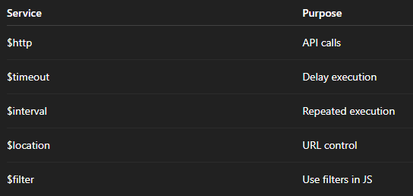
Built-in AngularJS Services
AngularJS provides built-in services:
Notes:
https://medium.com/@aakashgarg3108/introduction-to-servicenow-jelly-scripting-509a51c64147

Slide 6
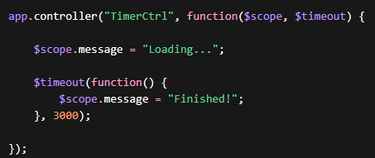

Built-in AngularJS Services
Example: $timeout
Delay Execution Example
HTML
Notes:
https://medium.com/@aakashgarg3108/introduction-to-servicenow-jelly-scripting-509a51c64147

Slide 7
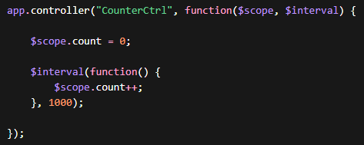
Built-in AngularJS Services
Example: $interval
Repeated Execution Example
Notes:
https://medium.com/@aakashgarg3108/introduction-to-servicenow-jelly-scripting-509a51c64147

Slide 8

Built-in AngularJS Services
$http Service
The $http service is one of the most common used services in AngularJS applications.
The service makes a request to the server, and lets your application handle the response.
Used to communicate with APIs.
Noteeee: $http returns a Promise.
Notes:
https://medium.com/@aakashgarg3108/introduction-to-servicenow-jelly-scripting-509a51c64147

Slide 9
Built-in AngularJS Services
$http Methods
The example above uses the .get method of the $http service.
The .get method is a shortcut method of the $http service.
There are several shortcut methods:
.delete()
.get()
.head()
.patch()
.post()
.put()
Notes:
https://medium.com/@aakashgarg3108/introduction-to-servicenow-jelly-scripting-509a51c64147

Slide 10
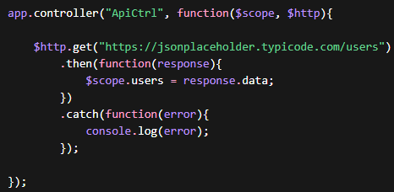

Built-in AngularJS Services
$http Service
GET Request Example
HTML
Notes:
https://medium.com/@aakashgarg3108/introduction-to-servicenow-jelly-scripting-509a51c64147

Slide 11
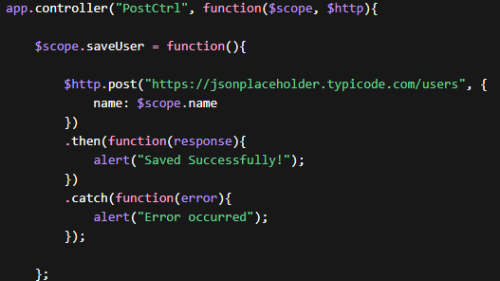

Built-in AngularJS Services
$http Service
POST Request Example
HTML
Notes:
https://medium.com/@aakashgarg3108/introduction-to-servicenow-jelly-scripting-509a51c64147

Slide 12
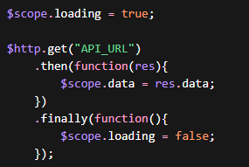

Built-in AngularJS Services
$http Service
Handling Loading State
HTML
Notes:
https://medium.com/@aakashgarg3108/introduction-to-servicenow-jelly-scripting-509a51c64147

Slide 13
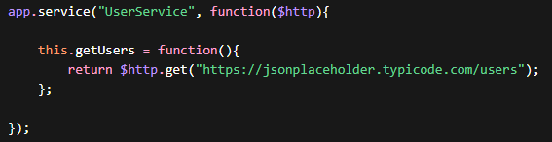
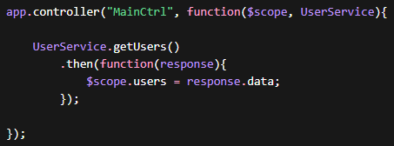
Built-in AngularJS Services
Creating Custom Service
Instead of writing API logic in controller:
We create a service.
Using Service in Controller
Notes:
https://medium.com/@aakashgarg3108/introduction-to-servicenow-jelly-scripting-509a51c64147

Slide 14
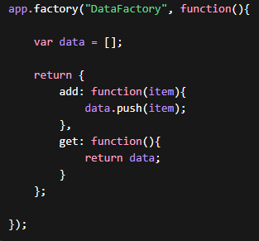
Factory
What is Factory?
Factory is another way to create service.
Notes:
https://medium.com/@aakashgarg3108/introduction-to-servicenow-jelly-scripting-509a51c64147

Slide 15
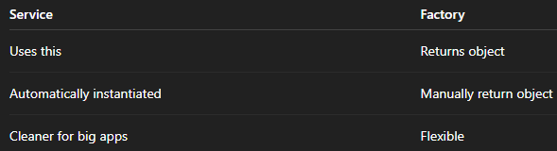
Factory
What is Factory?
Service vs Factory
Notes:
https://medium.com/@aakashgarg3108/introduction-to-servicenow-jelly-scripting-509a51c64147

Slide 16
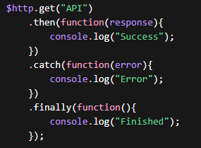
Promises
Promise = “Result will come later”
States:
Pending
Resolved
Rejected
Notes:
https://medium.com/@aakashgarg3108/introduction-to-servicenow-jelly-scripting-509a51c64147

Slide 17
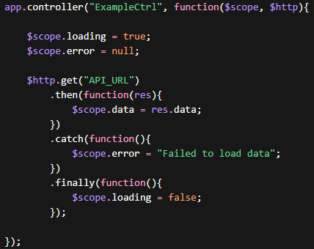

Promises
Real Example with Loading + Error
HTML
Notes:
https://medium.com/@aakashgarg3108/introduction-to-servicenow-jelly-scripting-509a51c64147

Slide 18
Task
Build Product Management App:
GET all products
POST new product
PUT a product
Delete a product
Show loading
Show error message
Use Service (not controller API call)
All in a good desgin
Notes:
https://medium.com/@aakashgarg3108/introduction-to-servicenow-jelly-scripting-509a51c64147

